Slide 1
Government polytechnic Jalgaon
Department Name-: Electronics And Tele-communication
Academic Year 2020-21
Subject Name And Code : Capstone Project–Execution And Report Writing (22060)
Class : EJ6I

Slide 2
Topic of capstone project-:
Electroplating bath parameters monitoring system in Spectrum Pvt.Ltd. Electroplating plant .

Slide 3
Presented By :
Prathamesh Saraf (11)
Mohit Bhangale (23)
Mandar Patil (24)
Mohish Khadse (25)
Under Guidance Of : Industry Guide
Prof . K.P.Akole Mr. S.D.Rade
( H.O.D. of E&TC Dept. ) (Head of R&D Dept. in Spectrum electrical Ltd.)

Slide 4
Problem definition
The problem given by the spectrum electrical industry is as-:
In the company electroplating plant there is a need of system which will monitor a parameters of electroplating bath which include electrolyte solution PH, temperature , carbon monoxide and smoke gas
After that display this collected data in manager’s office .

Slide 5
Objective
Flexible system -: System should be so flexible which will easily adapt the electroplating plant environment and can be easily transferred to another container. Also if require it can be modified as per further requirement(which includes switching action of the inlet and outlet valve of the electroplating bath,diluting the electrolyte solution etc )
Wireless system-: This monitoring system should be wireless because at the actual project implementing site there is no such place to carry the wires towards office
Alarm provision -: System should have the alarm provision which will inform that bath parameters has cross the threshold level.
Compact Size -: System should be compact so it can be attached at the site and can easily be carried to another bath if required

Slide 6
Proposed feature
The very first aim is to detect the change in the parameters govern by the bath this parameters are
PH and Temperature value of the electrolyte solution.
Smoke gas and carbon monoxide within the bath environment .
To compare those detected sensed values with the predefined standard value required for the bath
To obtain the wireless features in the project which will allow to send the collected data to the electroplating plant office(managers office).
To obtain the easy installation, flexible with hardware, compact system (system should be easily installed at another bath site).
To achieve the indication of change detected beyond the limited values of parameters .

Slide 7
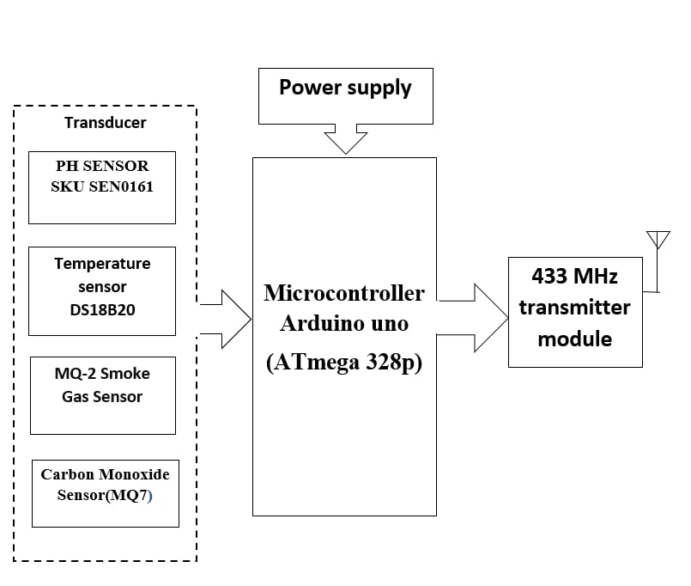
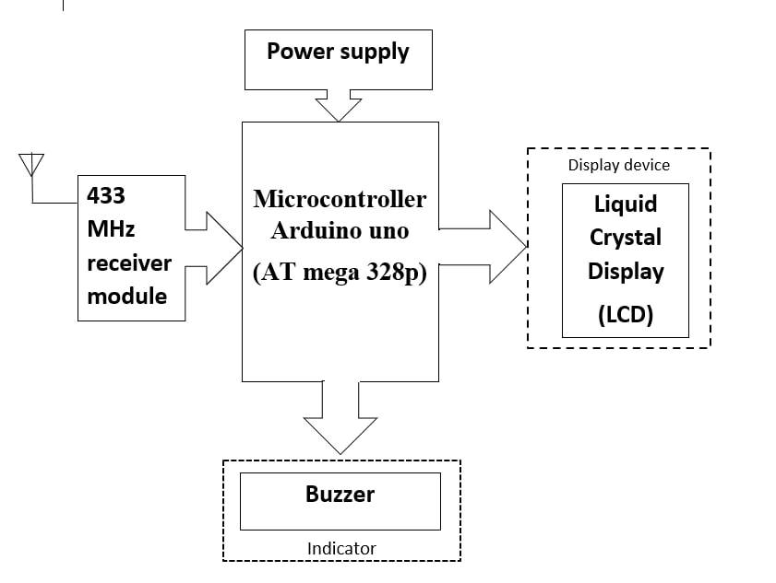
Block diagram
Fig . Data Acquisition And Transmitter Terminal
Fig . Data Receiver and display Terminal

Slide 8
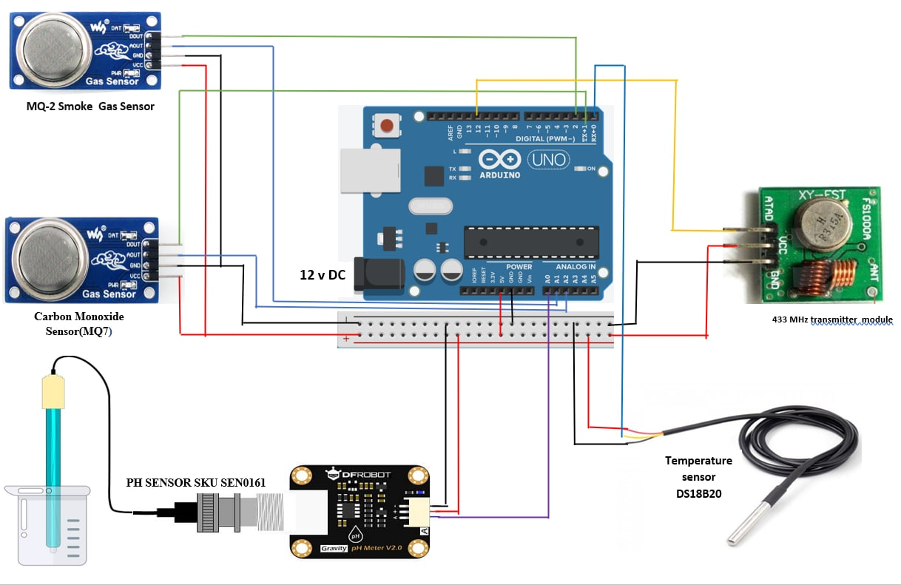
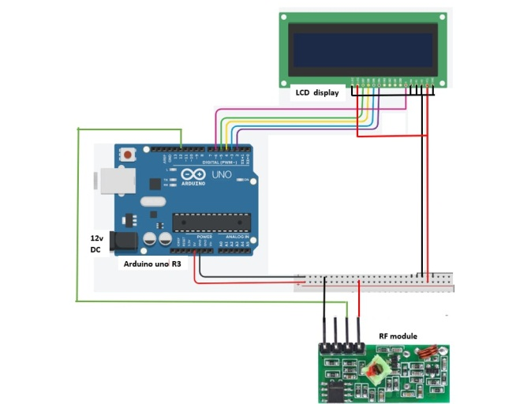
Circuit diagram
Fig . Sensor and Transmitter Terminal
Fig Receiver and Display terminal

Slide 9
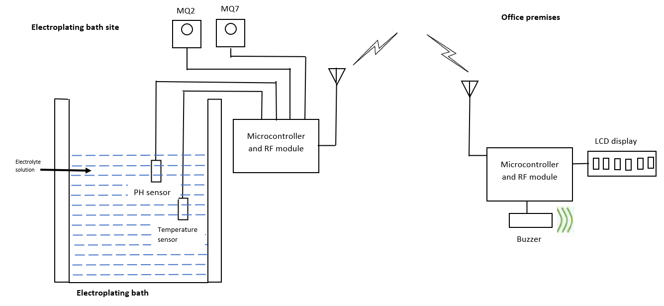
System operation

Slide 10
Future scope
Scalibility can be increased
Enable to IOT compliance standard
Data ;ogger to store the measure sensor data over a period of time .
Speaking voice alarm provision .
Self desister control provision. (to avoid accident prohability )

Slide 11
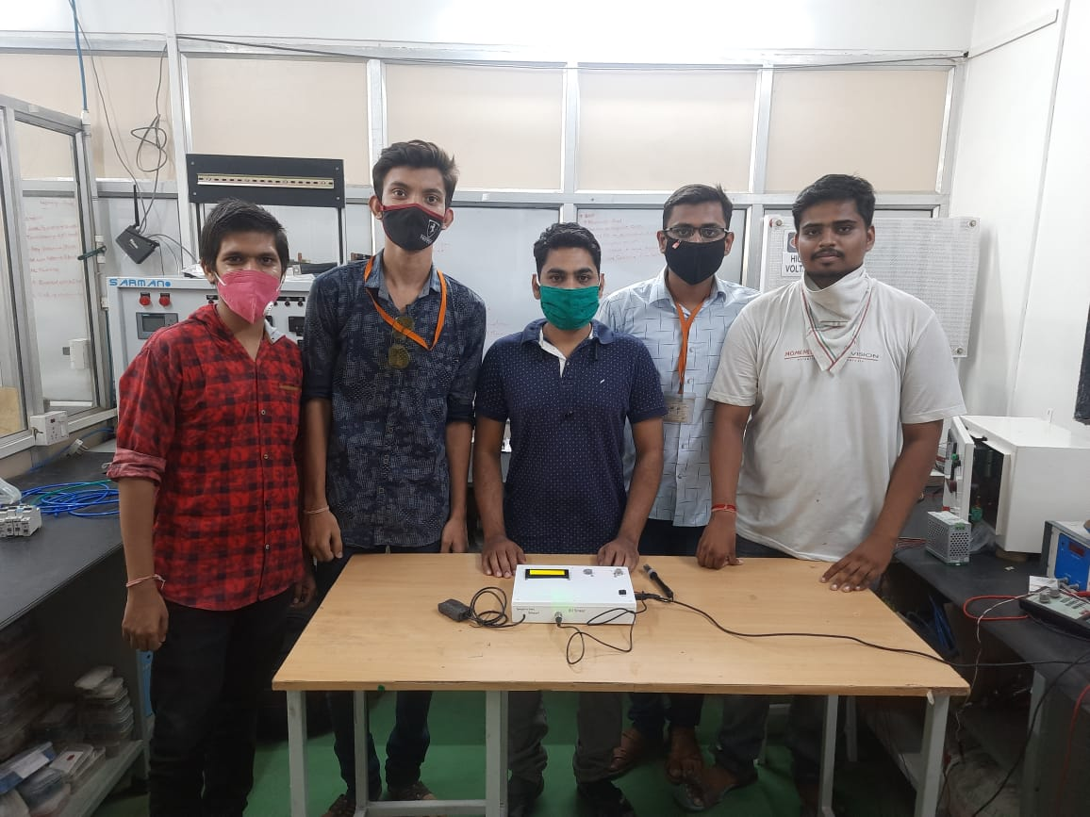
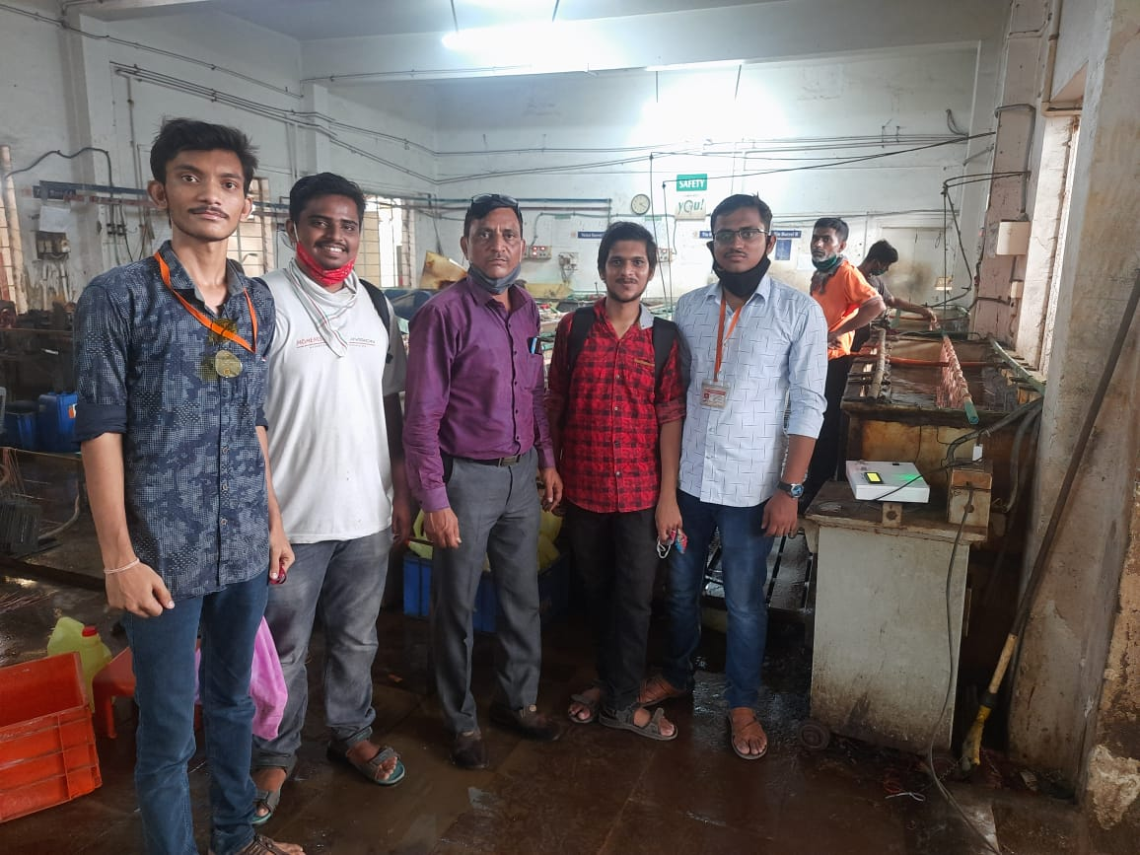
SPETRUM ELECTRICAL INDUSTRIES LIMITED , JALGAON
With industry guide Mr. S.D.Rade
(Head of R&D Dept. in Spectrum electrical Ltd.)
With plant manager Mr.B.G.Patil
(Electroplating Plant Manager )

Slide 12
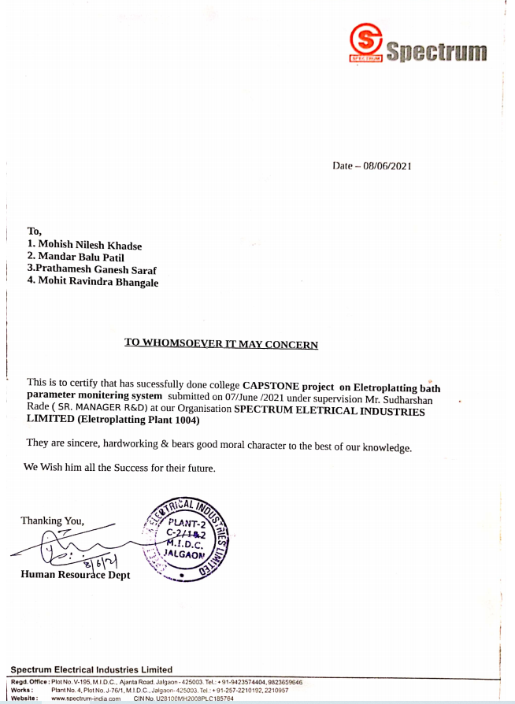

Slide 13
THANK YOU

